Slide 1



ECHO
Your Alzheimer’s Care App

Slide 2
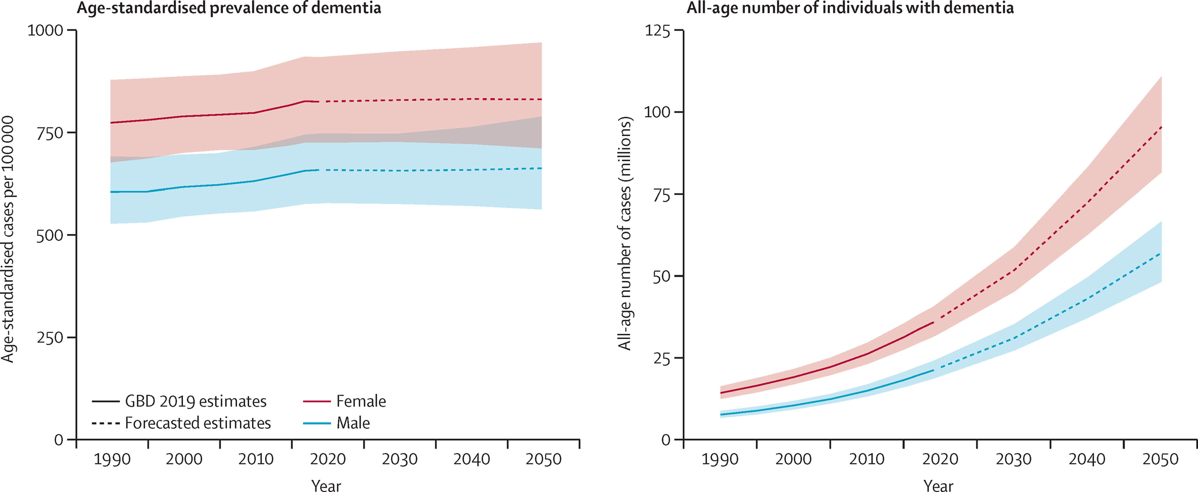

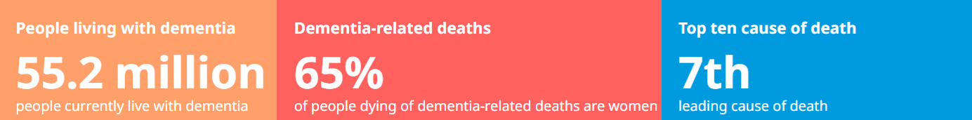
1
The Problem
78% of Alzheimer’s caregivers report burnout due to constant supervision
Patients often forget daily roles, tasks and faces leading to risk and stress
Patients often can’t use mobile apps or devices during moments of confusion
ECHO

Slide 3






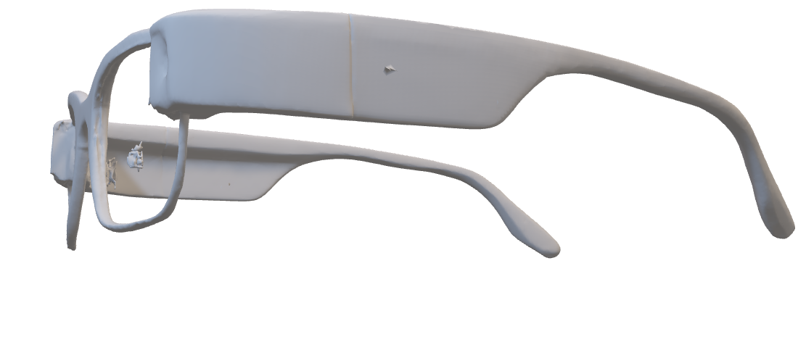
2
Existing players solving it...but poorly
Replica Glasses
CarePredict
MediAlert
Google Glasses
No visual context
No visual interface or assist
Purely reactive
Not medically designed
Lacks contextual awareness
Doesn't interact with patients
No real-time updates
Limited adoption
One-sided interaction
No emotional insight
Doesn’t address confusion
Uncomfortable form factor
ECHO

Slide 4
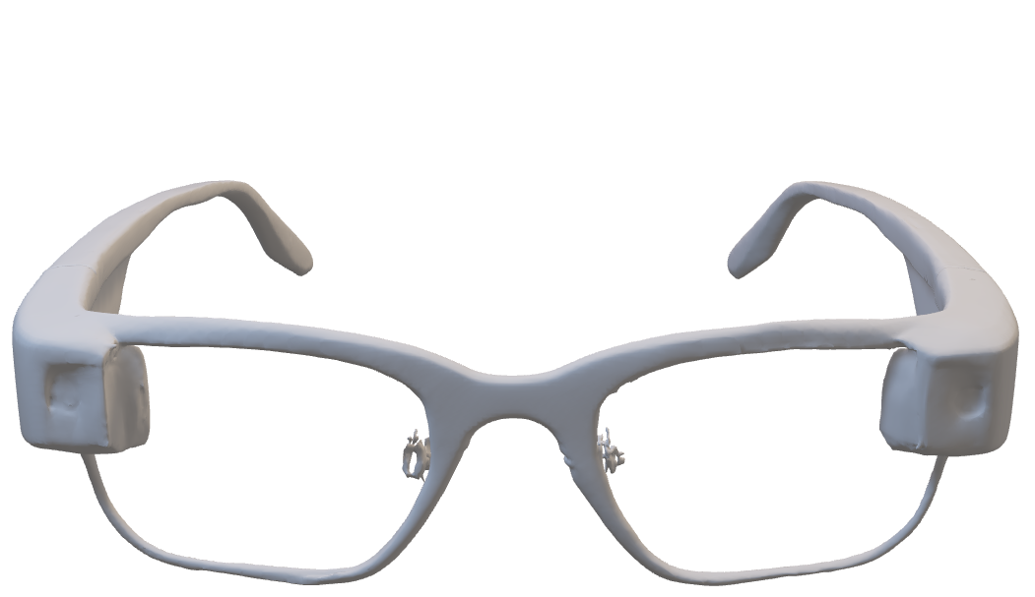
3
Introducing
ECHO
Real-time facial recognition
Voice assistant for reminders and reassurance
Learns patient routines
GDPR & HIPAA-aligned protocols
ECHO

Slide 5
4
Making it happen (Use-cases)
Current
Near Future
Distant Future
Wearable Memory Aid
Emotion & Fall Detection
Predictive Memory Health Monitoring
Caregiver Feedback Dashboard
Institutional Deployment & Policy Integration
Routine Guidance
ECHO

Slide 6
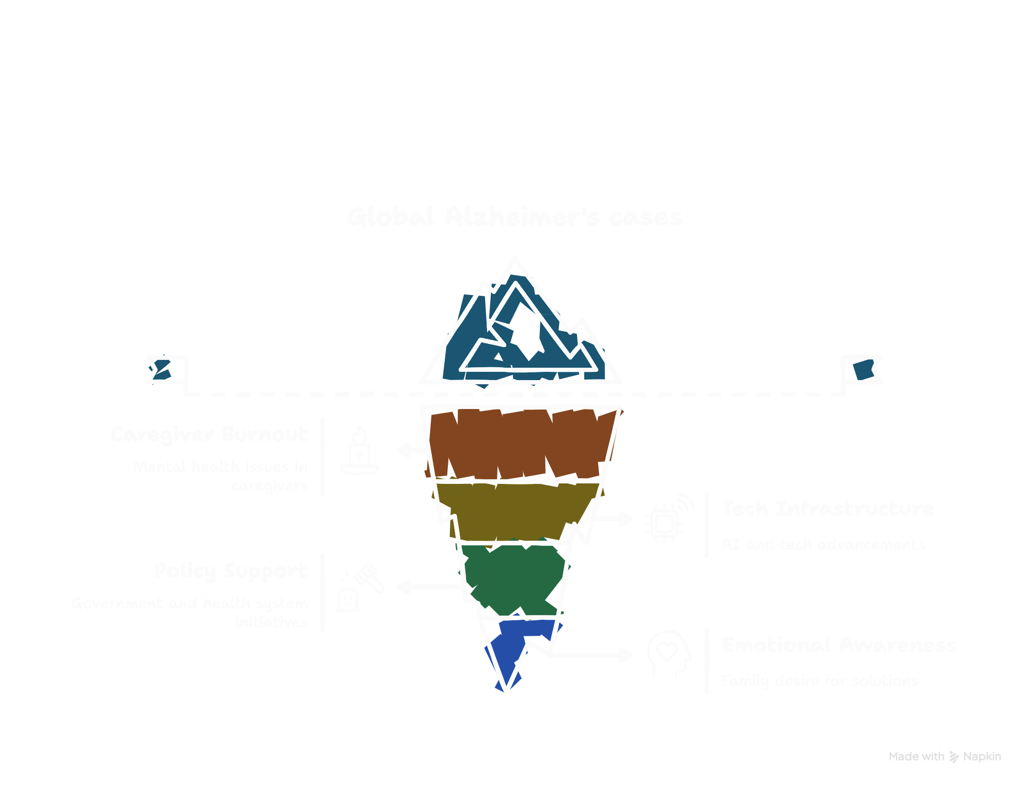
5
Why Now?
ECHO

Slide 7
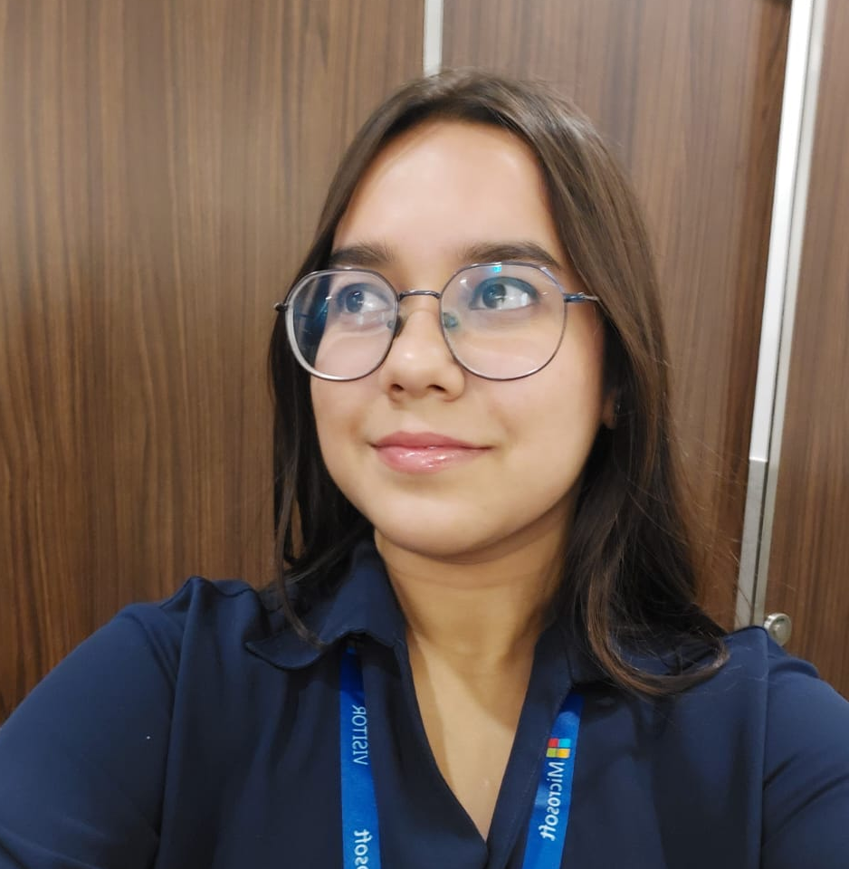

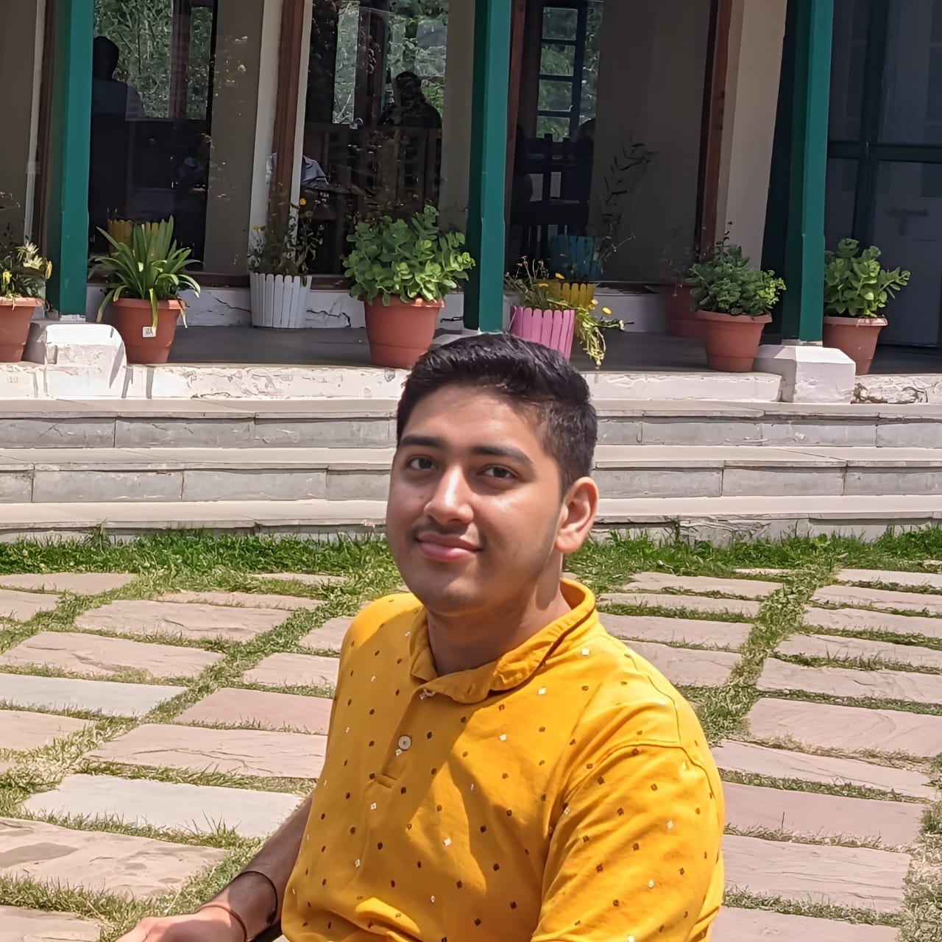
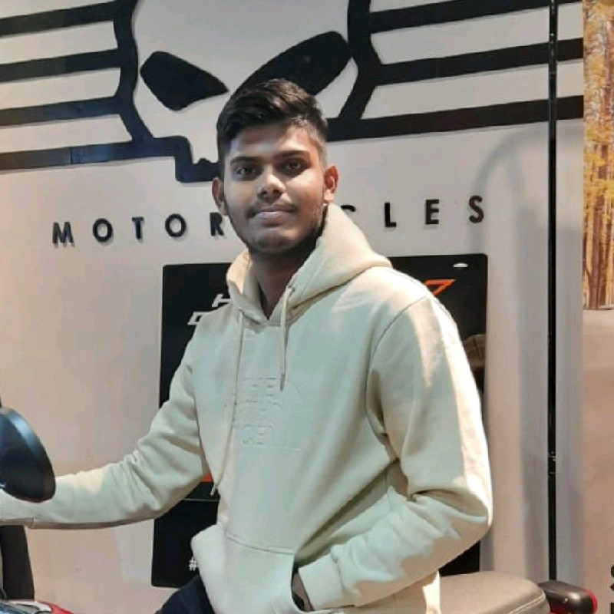
6
Why are we the ones to do it?
Built and deployed real-world AI and decentralized systems.
Archana Gupta
Ashutosh Rath
UI/UX Designer
IOT Squad
Hands-on experience designing and developing smart contract logic.
Worked extensively with cloud-based deployments and scalable systems.
Applied machine learning algorithms for behavior modeling.
Kartik
Satyabrat Sahu
ML Engineer
ML Engineer
ECHO

Slide 8
7
Here is how we make/will make money...
Q4 2025
First 100 pilot users onboard
Q1 2026
B2B partnerships with eldercare homes
Q4 2026
Break-even with 5,000 active users/subscribers
Open APIs for facial recognition, emotion detection, cognitive pattern alerts, and fall detection
Paid onboarding and certification for caregivers and partner clinics.
Anonymous cognitive data for use in research and diagnostics (ethically monetized)
Government and NGO contracts for wide-scale public deployment
ECHO

Slide 9
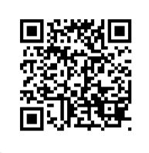
Satyabrat
Founder
satyabratsahu71@gmail.com
+91 82879 16162
ECHO
Improving Lives
https://github.com/Satyabrat2005/Echo

